Slide 1
POLICY MANAGEMENT SYSTEM
GROUP CODE: 4
GROUP GUIDE : MR. Dhwanir Shah
GROUP MEMBERS :
Contractor Mohammed H (3016)
Saiyed Rumaila R (3074)
Shah Zeel B (3060)

Slide 2

COMPANY PROFILE
COMPANY NAME: EXPERT WEB-DESIGNING
ADDRESS : 1st Floor , 124 Platinum Plaza , Opp. Kunj Mall , Nikol-Naroda Road,Ahmedabad,382 350.
CONTACT NUMBER : (+91) 8000436640.
CONTACT PERSON : Prashant Malvaiya.
EMAIL ID : info@expertwebdesigning.com
WEBSITE : www.expertwebdesigning.com

Slide 3
EXPERT WEB-DESIGNING is an Indian IT Company for Software Development ,Website Development, Web Hosting, Web Designing, Search Engine Optimization, Mobile Solutions and lot many IT and IT Enabled Services.
EXPERT WEB-DESIGNING is a Software Product based company who develops different software products and sell into Market. EXPERT WEB-DESIGNING is in Website Solutions and Mobile Solutions with SEO Services. EXPERT WEB-DESIGNING is only Product based company who creates products for their customer IT company and promote them.

Slide 4
Requirement Gathering
To create a Web-portal for the agent from where he can manage all the details of his/her clients.
To create an Android application for the clients , so that they can see all the policies they have purchased , their premium amounts , payment dates , new policies , maturity dates etc.

Slide 5
According to Stake holders
AGENT:
Agent can login to the system and access the login panel.
Agent can add the company and Policy details to present it to his/her clients.
Agent can manage the client details who are purchasing policy from him/her.

Slide 6
Agent can manage the data of client and policy purchased by them.
Agent can view and send reminder for policy premium to his or her client.
Send notification about new policy to all customers.
Agent can generate the various types of reports like pending premium amount report , Date wise policy opening reports etc.
Agent Can Generate Quotation for any policy/policies for the client by providing criteria like Budget / Installments etc.

Slide 7
CLIENT:
Client can login to the system and access its functionality.
Client can view his or her profile.
Client can view all the policy details which taken by him or her.
Client can view all the details about premium of policy which is paid by them.

Slide 8
Client can view the new policies for purchasing
Get reminder for unpaid premium and upcoming premium.
Get notification for new policy sent by the admin.
Client Can add policies he/she is interested in, to his/her wish list.

Slide 9
EXISTING SYSTEM
AGENT:
The Agent needs to visit the client personally and get various information from the client like Budget , Installments , which type of policy etc and show the client policies accordingly.
Once the client is interested in any of the policy / policies , the Agent needs to prepare a manual quotation for the client for his/her better understanding.
After the client is ready to purchase a policy , the agent need to make the client fill the policy form and get important documents like PAN Card / Passport / Election Card / Driving licence or any other Government generated documents.

Slide 10
Then the client needs to make the payment via cheque to the agent .
After the policy is purchased the main work of the agent starts , he needs to maintain a book / diary having all the details of his/her clients.
Important information like monthly/yearly reports , Unpaid premium , policy maturity etc needs to be created manually and is to be sent via post / courier service.
The agent needs to keep the client abreast about the premium in advance and if needed, has to go to the client’s house to collect the premium.
Every time a new policy is introduced the agent needs to meet the client to make him/her aware about the policy.

Slide 11
CLIENT :
The client needs to maintain a book / diary to be abreast about the policies that he/she purchased.
Every time the client needs any details about the policy like paid / unpaid premiums , maturity date , new policies , old policies etc.The Client needs to call the Agent to get all the details.

Slide 12
THE DRAWBACKS OF THE EXISTING SYSTEM
Tedious work : It is a tedious work to maintain all the records in a book / diary and keep searching pages for getting information .
Vulnerable : It is not secured as any person who has access to the book / diary has access to all the information .
Cannot Manage Large amount of clients: It is not possible to manage a large number of clients using this system as it is nearly impossible to remember each and every clients details.

Slide 13
Expensive & not eco-friendly : It is expensive as it needs extra staff to maintain large amount of clients.
Not Reliable : Books / Diaries are not reliable as if it is lost then it is impossible to get all the data back.
Consumes more time : The agent needs to visit to the client / call the client for small things like Premiums / reports etc.
Ineffective : It is not effective as the agent needs to manually create quotations , reports .

Slide 14
NEW SYSTEM
AGENT:
The Agent can send the brochure to the client via Email whenever the client requests for it.
Once the client is interested in any of the policy / policies , the Agent can generate one click Quotation for the client for his/her better understanding and can also send it via Email / post.
After the client is ready to purchase a policy , the agent need to make the client fill the policy form and get important documents like PAN Card / Passport / Election Card / Driving licence or any other Government generated documents and store the scanned documents in the database , so he can use it whenever needed .For Example : If the client needs to buy new policy no need to take the documents again.

Slide 15
Then the client needs to make the payment via cheque to the agent .
The Agent can enter the client details in the Web Portal and use it whenever needed.
Important information like monthly/yearly reports , Unpaid premium , policy maturity etc can be generated by one click and is sent via Email / SMS / Notification.
The agent can now keep the client abreast about the premium in advance by sending him Email / SMS , and if needed can go to the client’s house to collect the premium.

Slide 16
Every time a new policy is introduced , The agent can send Email / Notification / SMS to the client to make him/her aware about the new policy.
CLIENT :
The client can download the application in his/her phone and manage all his details and can view all his details by just signing into the application.
Every time the client needs any details about the policy like paid / unpaid premiums , maturity date , new policies , old policies etc. He/she can login into the application and can check them.

Slide 17
THE ADVANTAGES OF THE NEW SYSTEM
Time Variant : It saves a lot of time as it can generate Quotations/Reports in no time .
Secured : It is secured as only the authorized person can access the data.
Can Manage Large amount of clients: It is possible to manage a large number of clients using this system as each and every clients details are stored unlike the previous system.

Slide 18
Inexpensive & eco-friendly : It is Inexpensive as it no loner needs extra staff to maintain large amount of clients .
Reliable : If in case the data is lost from the system , it can be recovered .
Consumes less time : The agent no longer needs to visit to the client / call the client for small things like Premiums / reports etc.

Slide 19
PLATFORM
FRONT END:JSP & Servlet
Android (Android Studio 2.1).
BACK END: MySQL (5.7.13)
PRESENTATION TOOL : MS POWER POINT 2007
DOCUMENTATION TOOL : MS WORD 2007
DIAGRAM TOOL : MS VISIO 2007

Slide 20
WHY JSP OVER PHP ?
Anything you can do with PHP, you can do with JSP; the reverse is not true
JSP is much more powerful, since it has access to all the Java libraries. PHP only has access to PHP libraries
JSP is Object-Oriented, so leads to cleaner code that's easier to debug, maintain, and improve. (PHP also allows objects, but the object model is more primitive, and most scripted pages ignore PHP objects and just use normal variables.)
The equivalent syntax in JSP is just as simple to learn, so you can get up and running just as quickly -- that is, there's no extra start-up cost in using Java, at least not a significant one

Slide 21
With JSP, if the code inside a page gets too big, or if you want to use it elsewhere, you can cut it out, make it into a Java class, and invoke it from anywhere in your application (even not from a page). With PHP, you're stuck inside the HTML box.
JSP's concept of state management and persistence is more explicit and powerful than PHP's. With JSP, you can specify whether a variable persists for the page, the request, the session, or the application(or if it's just local to the function). The JSP engine automatically does the right thing with cookies so you have access to the variable on later requests. With PHP, you just have "global" and "not global", you don't have automatic session management, and have to do your state thing manually with cookies or hidden variables.

Slide 22
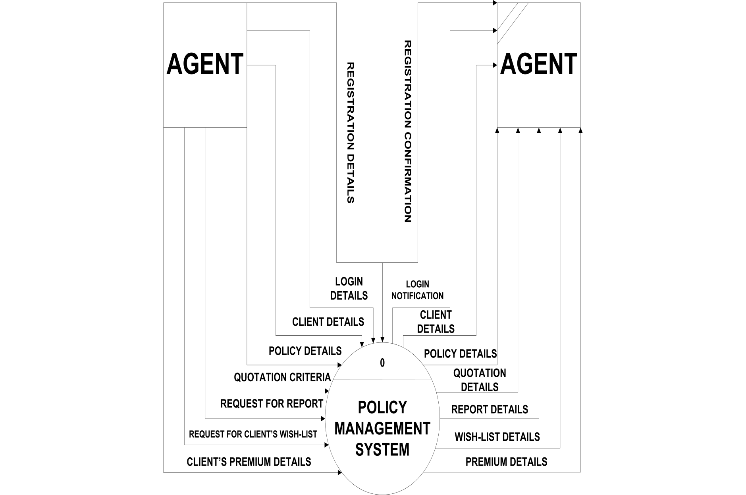
DATA FLOW DIAGRAMS Context Level

Slide 23
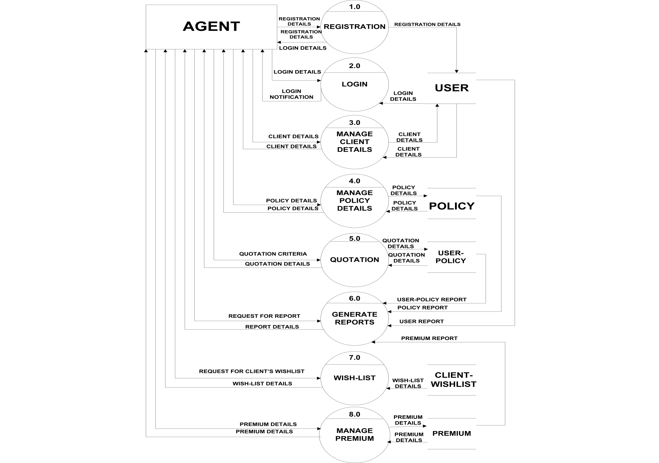
First Level

Slide 24
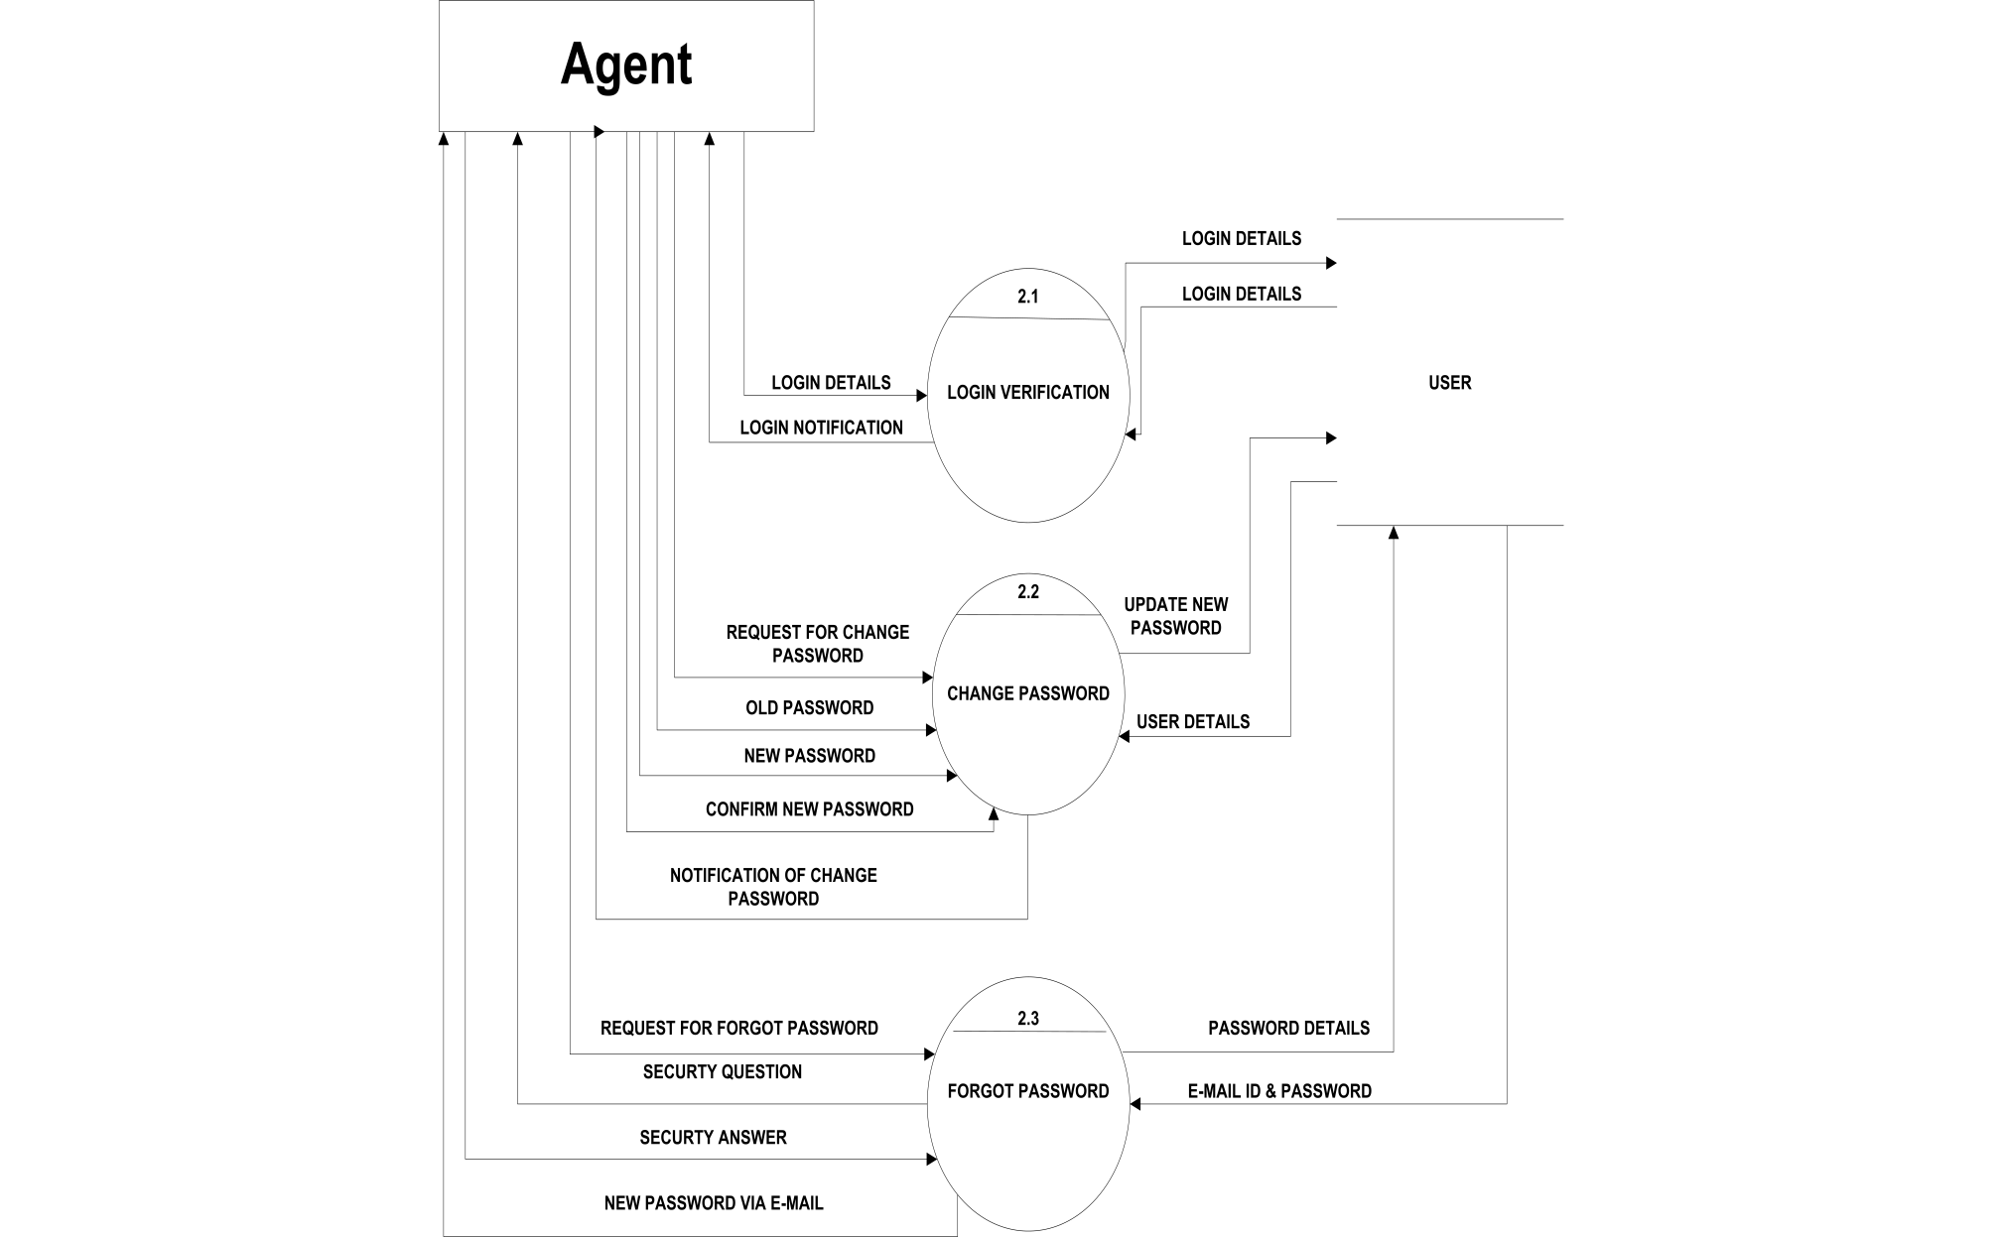
Second Level

Slide 25
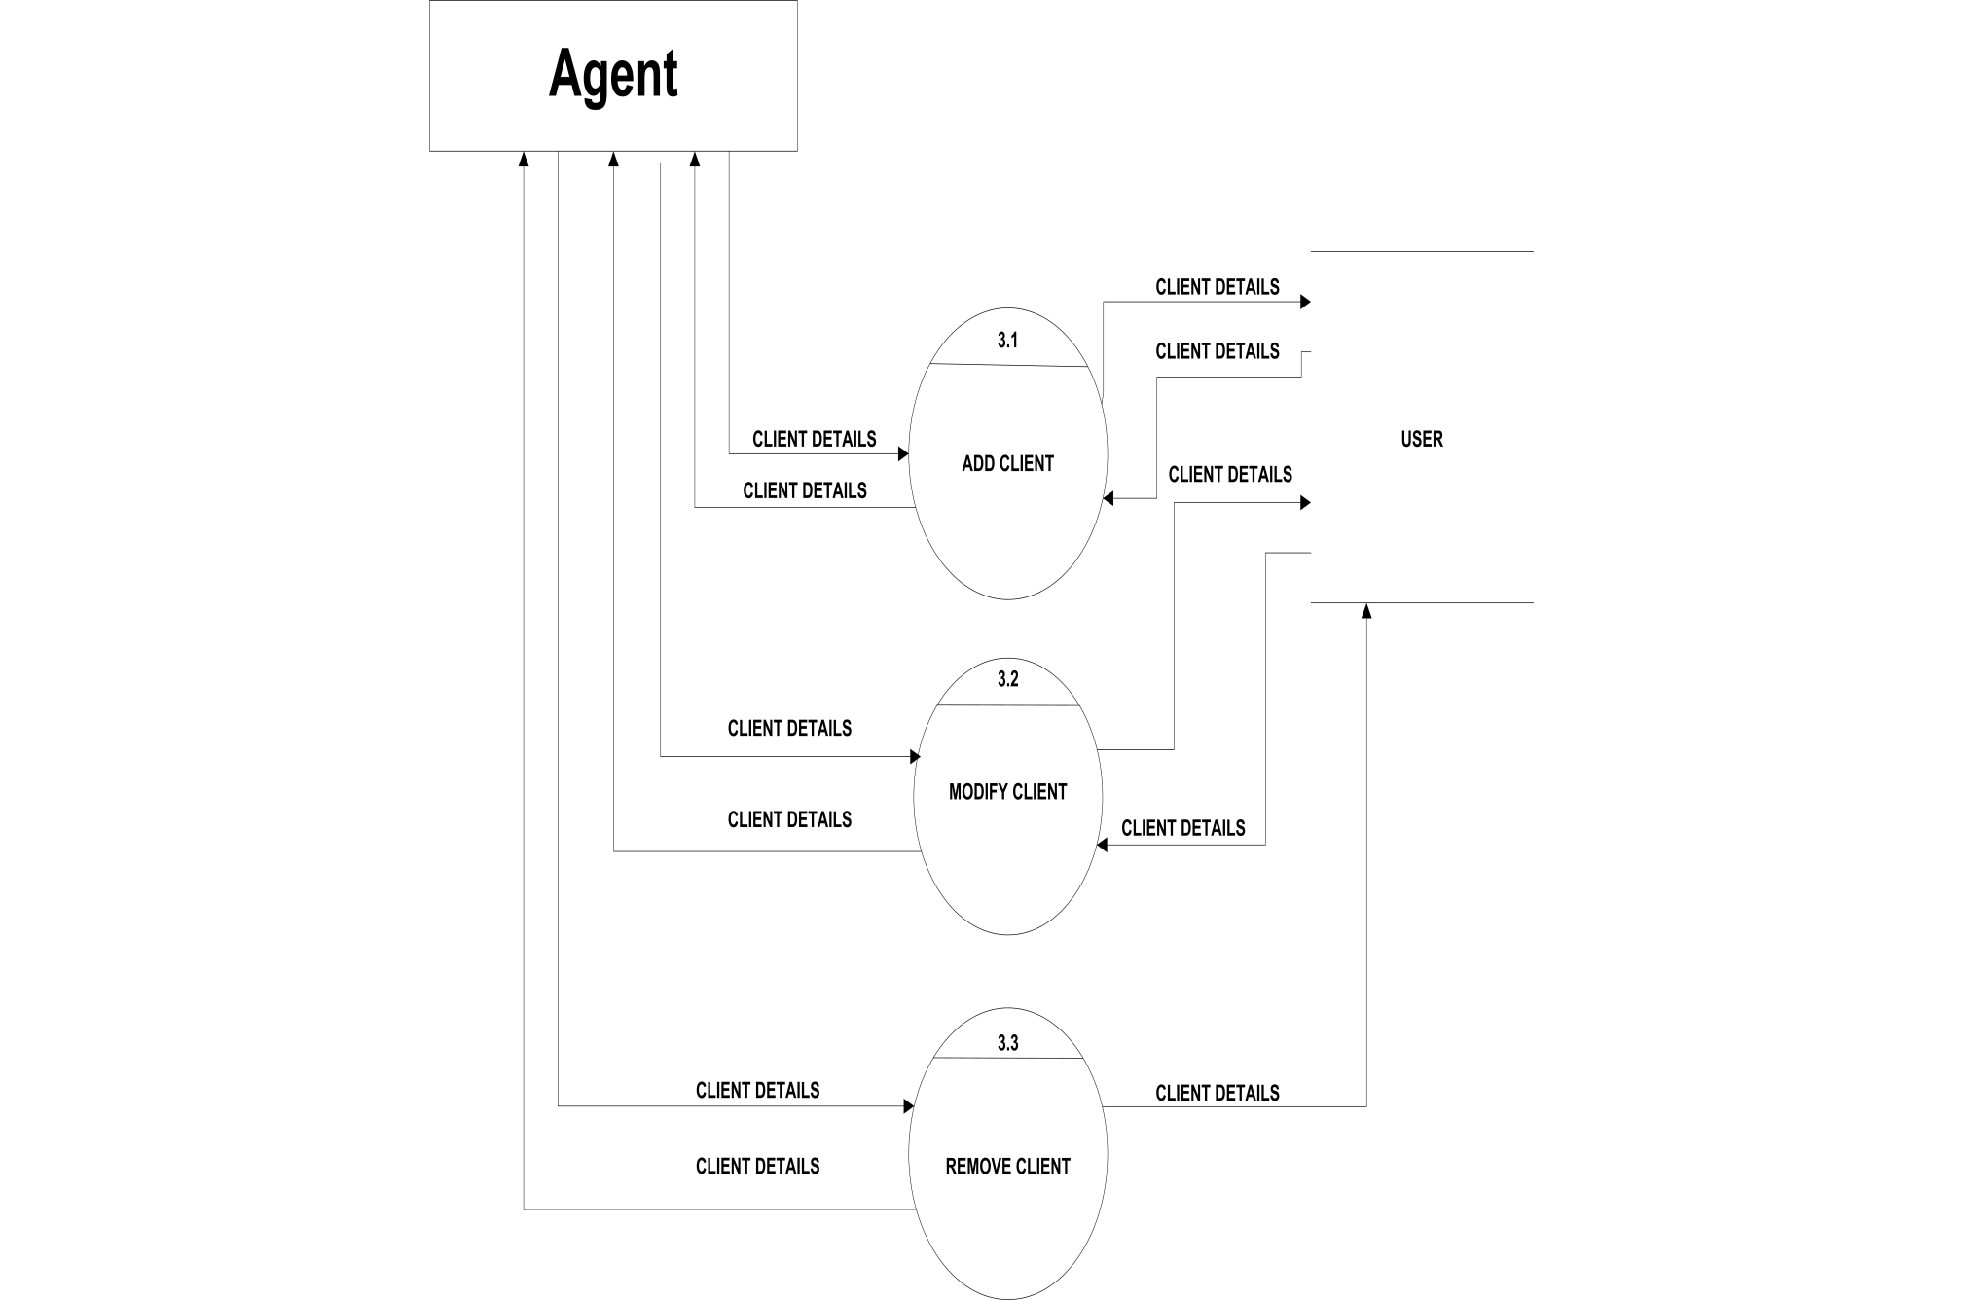

Slide 26


Slide 27
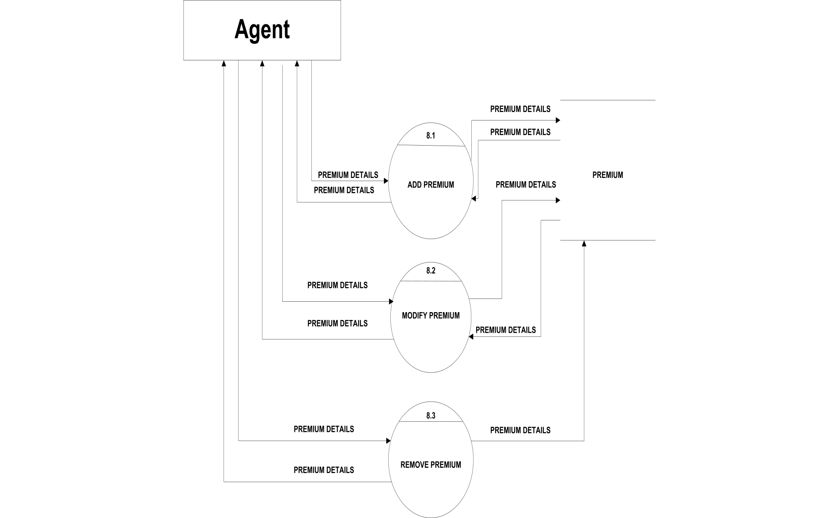

Slide 28
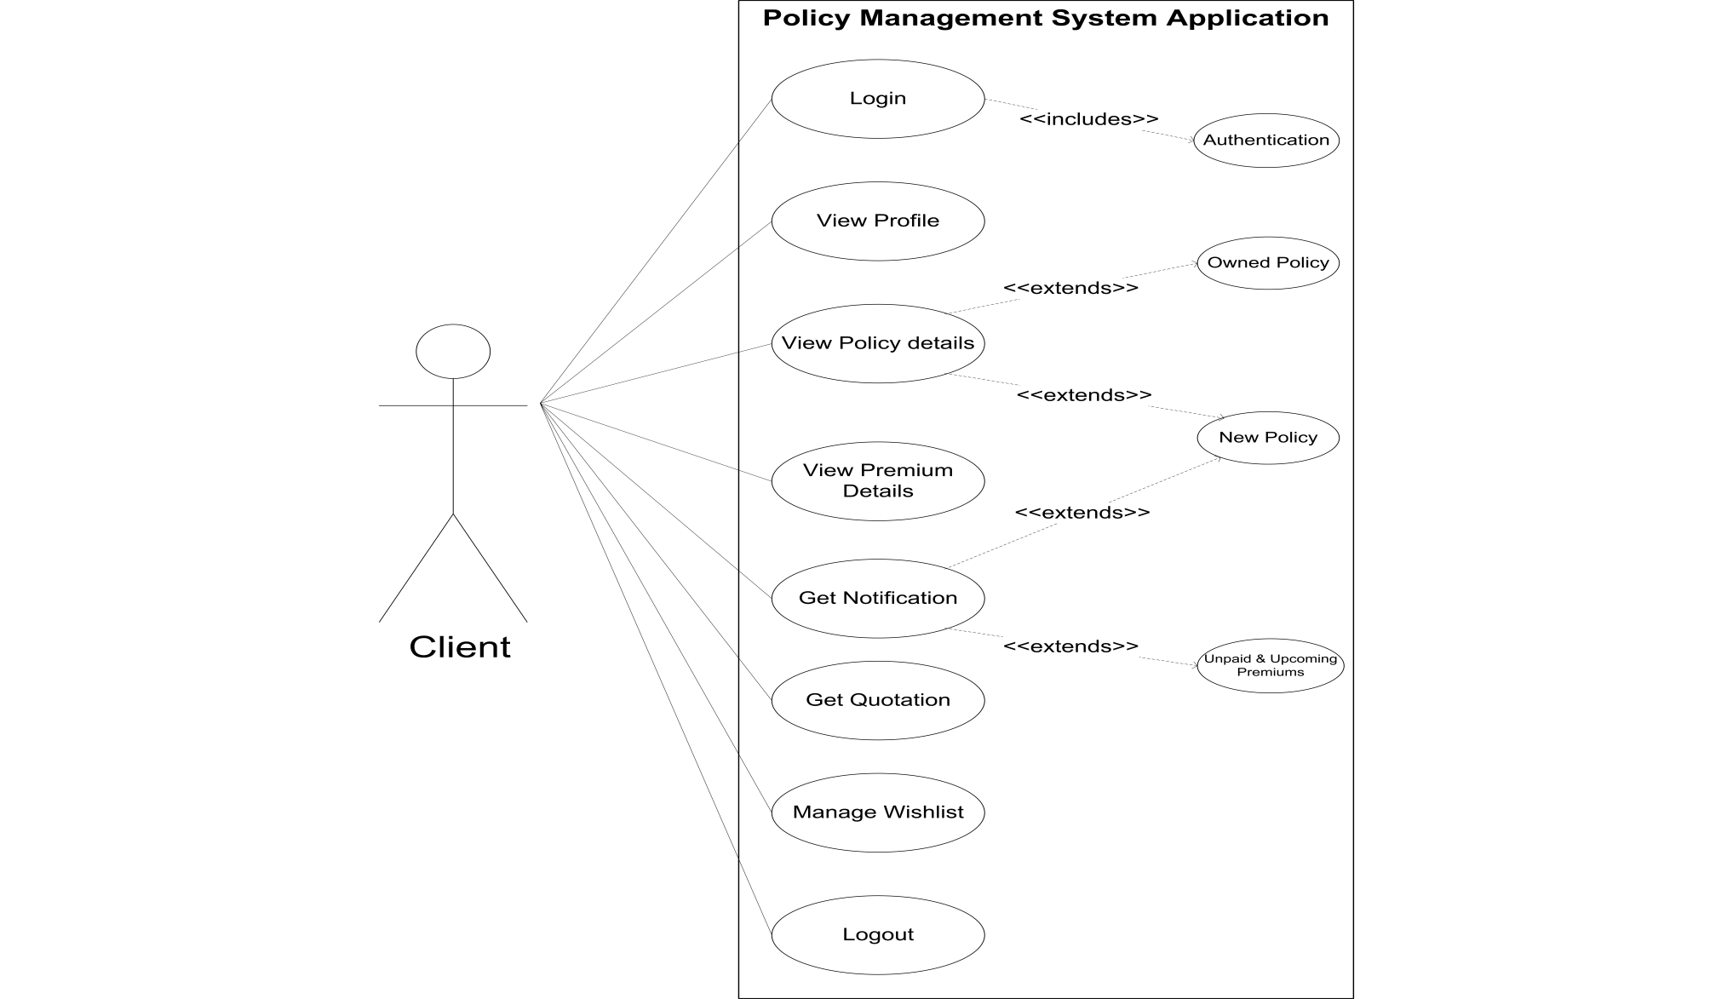
UML DIAGRAMS USE-CASE DIAGRAM

Slide 29
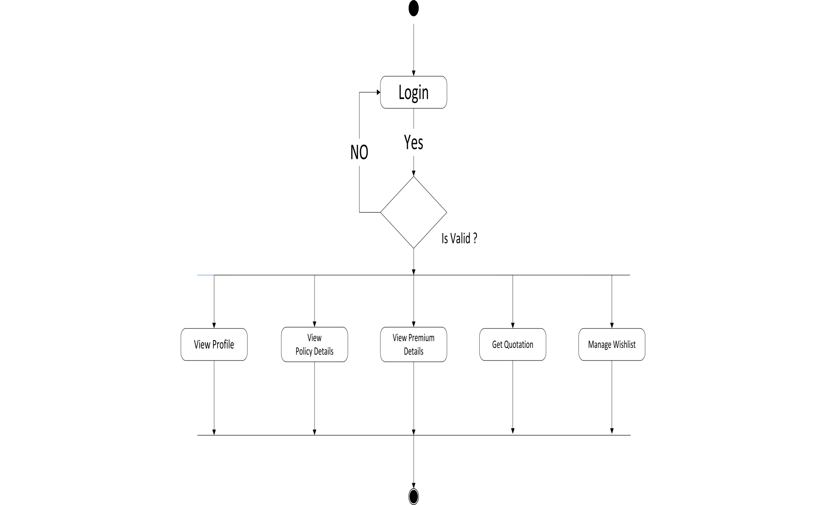
ACTIVITY DIAGRAM

Slide 30
ANY QUESTIONS ?

Slide 31
THANK YOU

